Slide 1
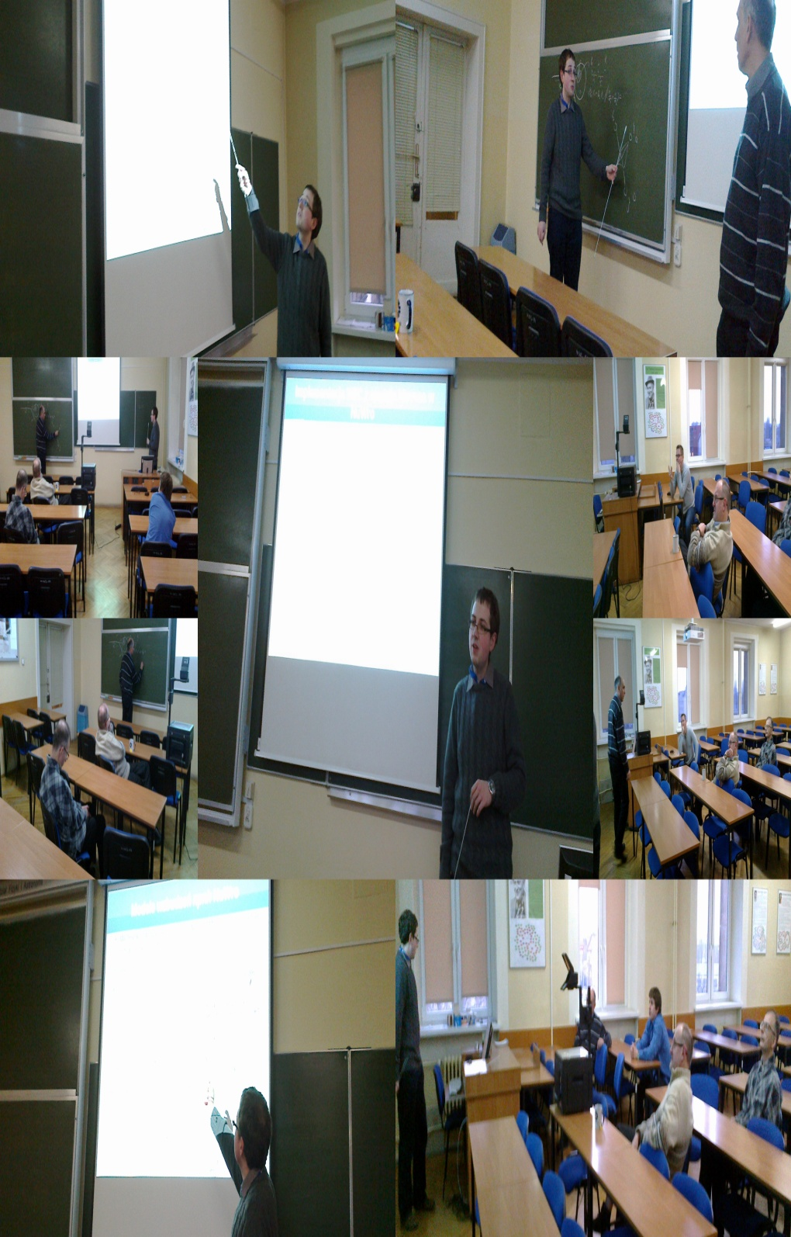


Neutrino Physics Division
→
Wrocław Neutrino Group” by
Krzysztof M. Graczyk
ν @ IFT @
ν @ IFT @

Slide 2
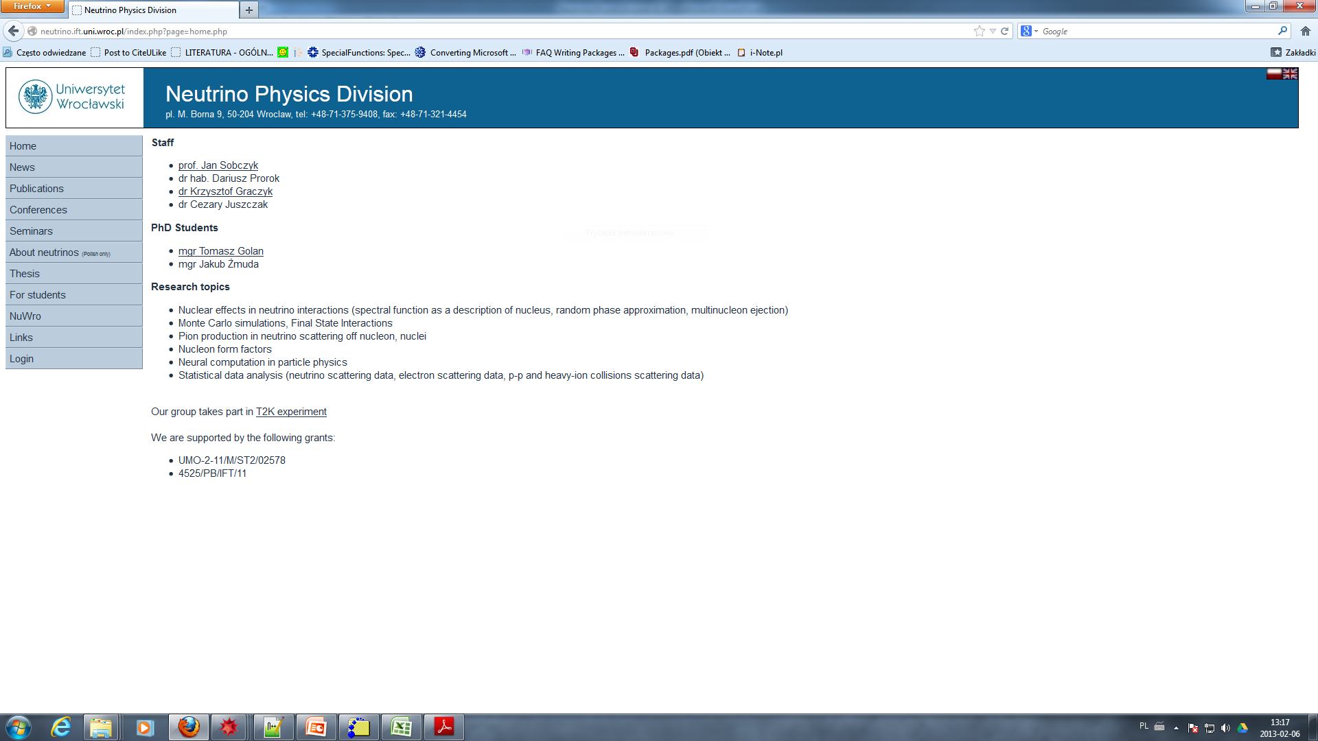
http://wng.ift.uni.wroc.pl or http://neutrino.ift.uni.wroc.p
Keywords:
  ν-nucleon
  ν-nucleus scattering (RPA, Spectral Function, MEC, FSI, nuclear cascade models)
  structure of the nucleon and Δ(1232) resonance (nucleon and transition form factors)
  single π production induced by ν-N,A interactions
  Monte Carlo simulations
  statistical data analysis, neural networks
  T2K experiment, neutrino oscillations
  electron-proton scattering (two photon exchange effect)
Methodology
  quantum field theory
  many body theory
  physics of hadrons
  relativistic hadrodynamics, mean field theory
  chiral field theory
Data
Analysis
Experiment
Monte Carlo
Theory
Neural
Networks
ν @ IFT @

Slide 3
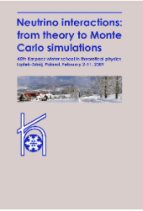
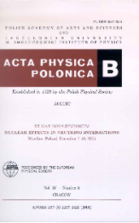
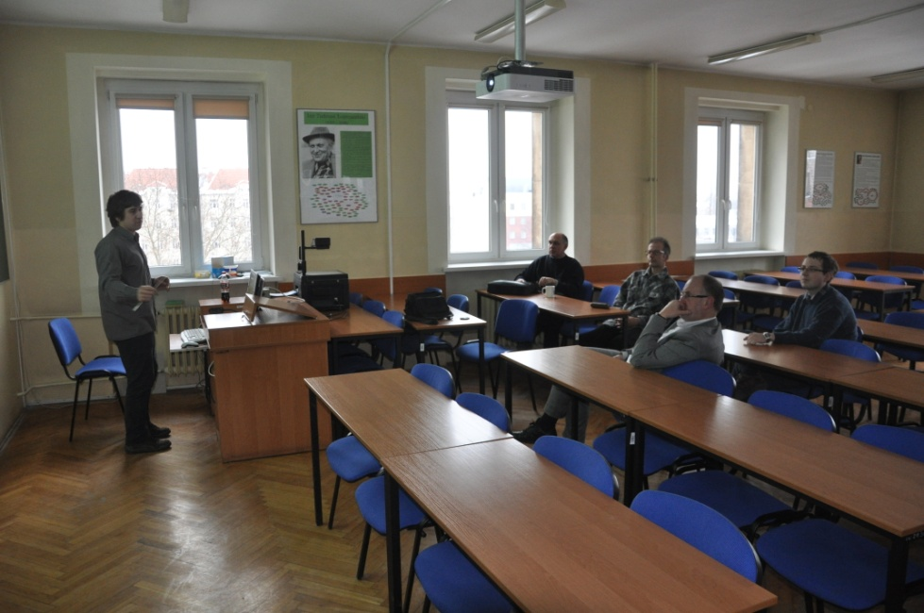
Master of Science
Wroclaw Neutrino
Group
2005, Ph.D.
K. Graczyk
2006, Ph.D.
J. Nowak
(Minesota St. U.)
Winter
School
2009
2013, Ph.D.
T. Golan
Pasternak
Kobyliński
Juchnowski
ICARUS
around
2001
T2K
Nowak
Żmuda
2008, Ph.D.
A. Ankowski
(Rome U.)
Gonera
2005, Ph.D.
J. Pasternak
(Imperial Colege)
Golan
2013, Ph.D.
J. Żmuda
STAFF
prof. J. Sobczyk
dr. hab D. Prorok
dr K. Graczyk
dr C. Juszczak
mgr J. Żmuda
mgr T. Golan
Ankowski
Dutkiewicz
Max Born
Symposium
2005
Active participation
in:
NuInt (every 1.5 y.)
and
NuFact (every y.)
conferences
A cooperation with
neutrino groups from
Warszawa,
Kraków,
Katowice
ν @ IFT @

Slide 4
1 GeV ν’s → motivation
Neutrino Oscillations
Disappearance of ν_{μ} (Far and Near Detectors)
Appearance of v_{e}(T2K experiment)
Appearance
T2K experiment
K2K
E about 700 MeV
Disappearance
Rather Practical Motivation
Neutrino oscillation experiments
→ a need to constrain better systematic errors.
  neutrino-nucleon cross sections uncertainties are still around 20-30\%.
  in all the cross section measurement experiments the neutrino flux was known with a poor precision
  interactions occur on nuclei with many complications coming from nuclear effects.
M. H. Ahn, Phys.Rev. D74 (2006) 072003
Fundemental Motivation
Neutrino, electron – nucleon, nuclei scattering
weak, electromagnetic probe of the nucleon, nuclei
Electrweak structure of hadrons
ν @ IFT @

Slide 5
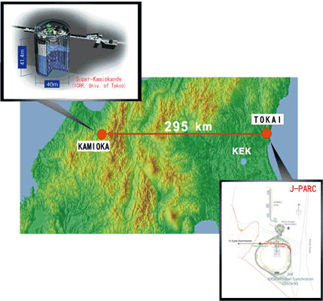
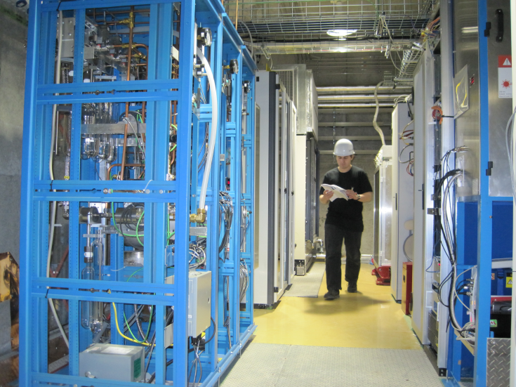
T2K
Experiment
Measurement of ν_{μ} → ν_{e} (i.e., the confirmation that θ₁₃ > 0)
precision measurements of oscillation parameters in ν_{μ} disappearance;
a search for sterile components in ν_{μ} disappearance by observation
of neutral-current
The T2K collaboration has about 500 members from
56 institutes in 11 countries.
We are the only theoretical group in T2K
(J. Sobczyk, T. Golan, J. Żmuda): software development
Phys.Rev.Lett. 107 (2011) 041801
Phys.Rev. D85 (2012) 031103
ν @ IFT @

Slide 6
The 1 GeV neutrino scattering off nucleons, nuclei
ν @ IFT @

Slide 7
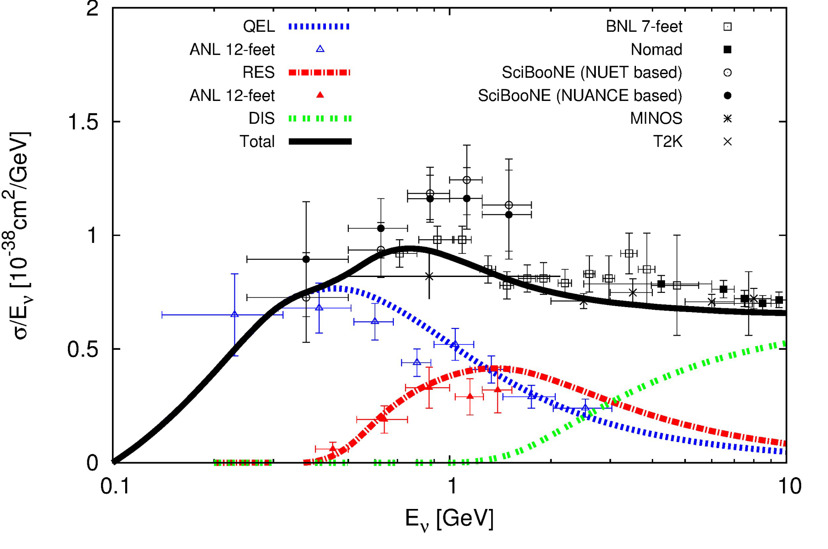
ν-nucleon
μ⁻
QE
ν
p
n
μ⁻
SPP → RES
p
ν
n
μ⁻
π⁺
SPP → Non-RES
p
Δ,...
ν
KMG, C. Juszczak, J.T.Sobczyk,
Nucl.Phys. A781 (2007) 22
KMG, AIP Conf.Proc. 1222 (2010) 238
n
π⁺
p
K.M.G, J. T. Sobczyk, Phys.Rev. D77 (2008) 053001,
Phys.Rev. D77 (2008) 053003.
K.M.G et al. Phys.Rev. D80 (2009) 093001.
K.M.G, AIP Conf.Proc. 1405 (2011) 134-139
etc.
Hadronic and mesonic degrees of freedom
Chiral filed theory motivited description
Quark model motiveted approach
Isobar model
Quark-Hadron Duality
π
μ⁻
p
DIS
ν
π⁻
J. Morfin, J. Nieves, J. T. Sobczyk,
Adv.High Energy Phys. 2012 (2012) 934597
ν @ IFT @

Slide 8
ν-nucleus
Z or W
QE and SPP can look the same in the detector
Problem of reconstruction of neutrino energy
π
N
One body currents from neutrino-nucleon scattering: an input of nuclear models
Impuls approximation
Fermi Gas model, a ground state of the nucleon
Spectarl function approach
A bare nuclear model dressed by: e.g. RPA 1n-1h excitations, calculatins within relativistic HadroDynamics .
SF: A.Ankowski, J.T.Sobczyk, Phys.Rev. C74 (2006) 054316
Phys.Rev. C77 (2008) 044311
KMG, J.T.Sobczyk, Eur.Phys.J. C31 (2003) 177,
KMG, Nucl.Phys. A748 (2005) 313
ν @ IFT @

Slide 9
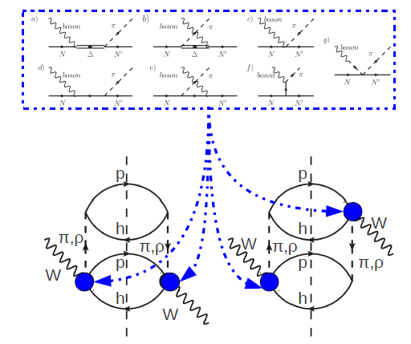
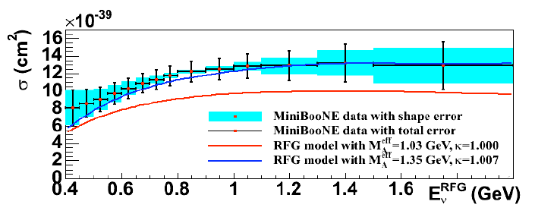
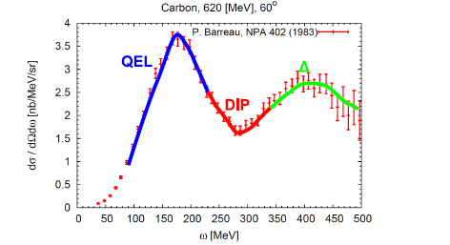
problem of the axial mass
one has to take into account MEC
Contribution (beyond one body current)
Final State Interaction
Pion production and absorbtion etc.
From J. Żmuda
Seminar of T. Katori
J.T.Sobczyk, J.Żmuda, arXiv:1210.6149
J.T.Sobczyk, Phys. Rev. C86, 015504 (2012)
C. Juszczak, J.T.Sobczyk, J.Żmuda, Phys.Rev. C82 (2010) 045502
K.M. Graczyk, C. Juszczak, J.T.Sobczyk, T. Golan, will be available next week
FSI: propagation of nucleons throw nuclei, →
Metropolis algorithm → NuWr
ν @ IFT @
Tomek Golan Movie

Slide 10
Experiment at Home
Monte Carlo simulations
with
NuWro
ν @ IFT @

Slide 11
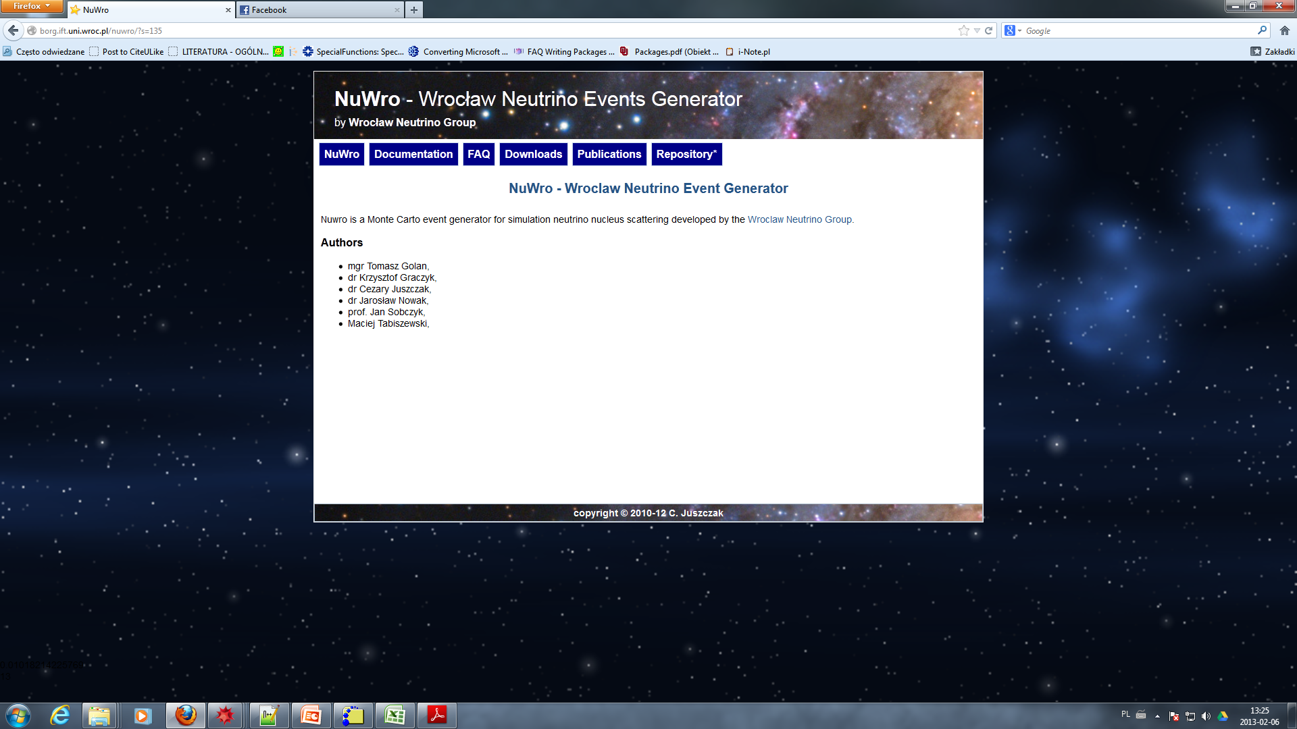
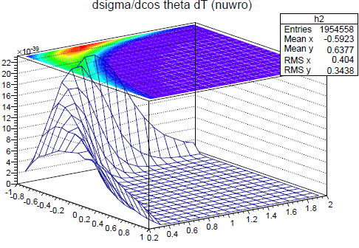
NuWro (Neutrino-Wrocław) Monte Carlo Generator
Selected papers:
C. Juszczak, T. Golan, J.T. Sobczyk, Phys. Rev. C86 (2012) 015505
C. Juszczak , J. T. Sobczyk, J. Żmuda, Phys. Rev. C82 (2010) 045502
C. Juszczak, Acta Phys.Polon. B40 (2009) 2507
J. Nowak, J. T. Sobczyk, Acta Phys.Polon. B37 (2006) 1955
C. Juszczak, J. A. Nowak, Nucl. Phys. Proc. Suppl. 159 (2006) 211
J. T. Sobczyk, J. A. Nowak, K.M. Graczyk, Nucl.Phys.Proc.Suppl. 139 (2005) 266
Authors:
mgr Tomasz Golan
dr Krzysztof Graczyk
dr Cezary Juszczak
dr Jarosław Nowak
prof. Jan Sobczyk
Maciej Tabiszewski
mgr Jakub Żmuda
All major neutrino-nucleus interaction channels (QEL, DIS, RES and COH)
Covers ν energies from MeV to TeV
density profiles and binding energies for most of nuclei
Local Fermi Gas and Spectral Function models of nucleus.
Intra-Nuclear cascade with pion-nucleon and nucleon-nucleon scattering.
scattering of complex neutrino beams on real detector geometries
the detector geometry is read from a data file (NuWro can be used by many different experiments)
The object oriented data analysis –compatible with root CERN frametool.
NuWro is the firts MC generator to
  include such dynamical effects like spectral function and Meson Exchange Current.
  has an online interface http:/nuwro.ift.uni.wroc.pl
  It is a probably the fastest event generation, compared to other codes.
ν @ IFT @
ν @ IFT @

Slide 12
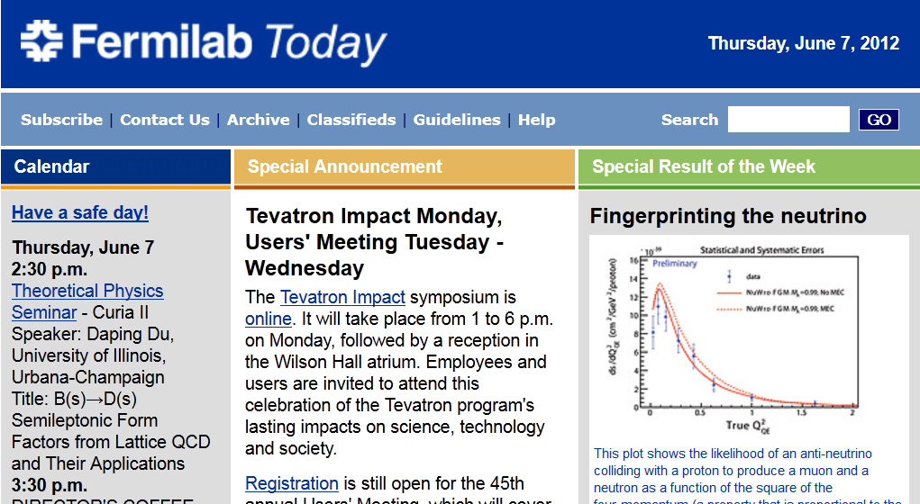
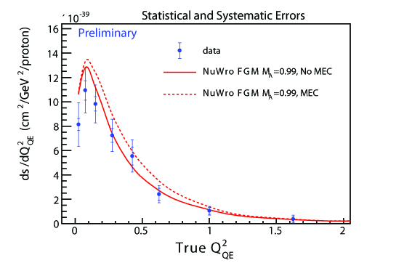
cross section mesurements by Minerva vs. NuWro
ν @ IFT @

Slide 13
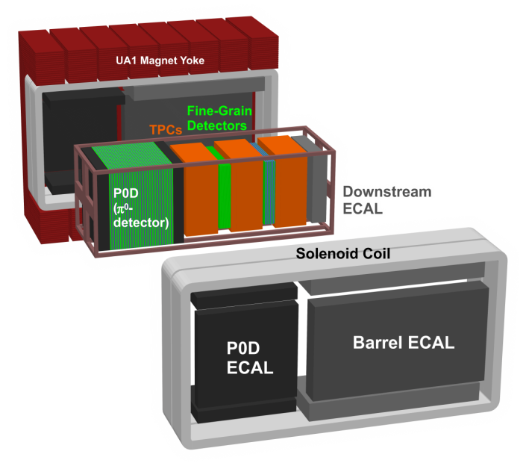
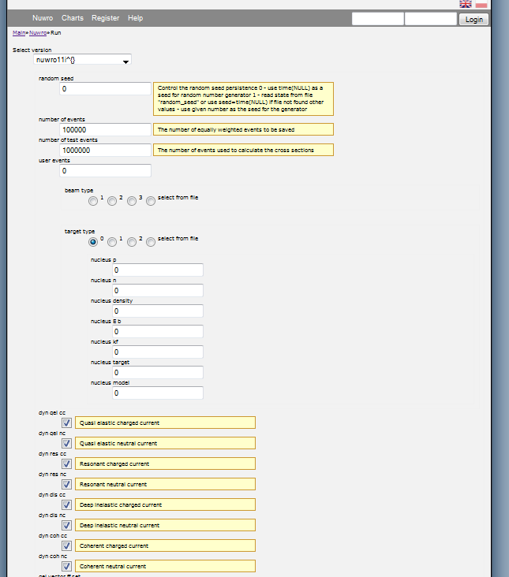
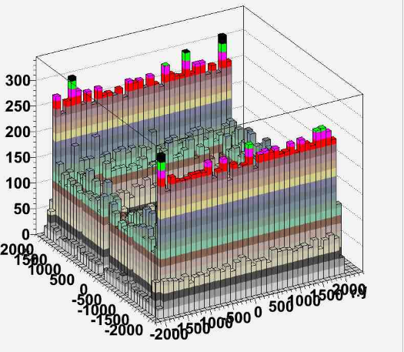
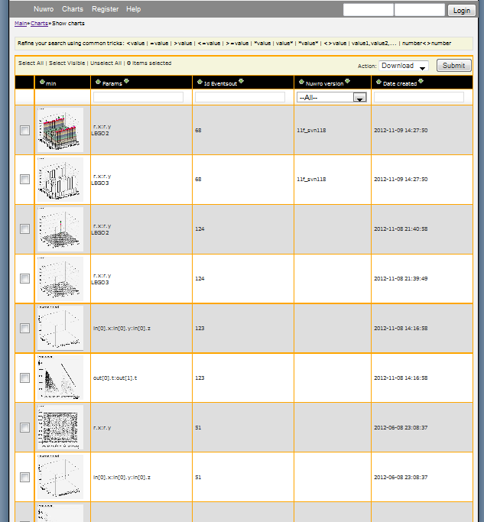
Msc. Thesis of Mirosław Nyznar
→ almost acomplished
running online
ν @ IFT @

Slide 14
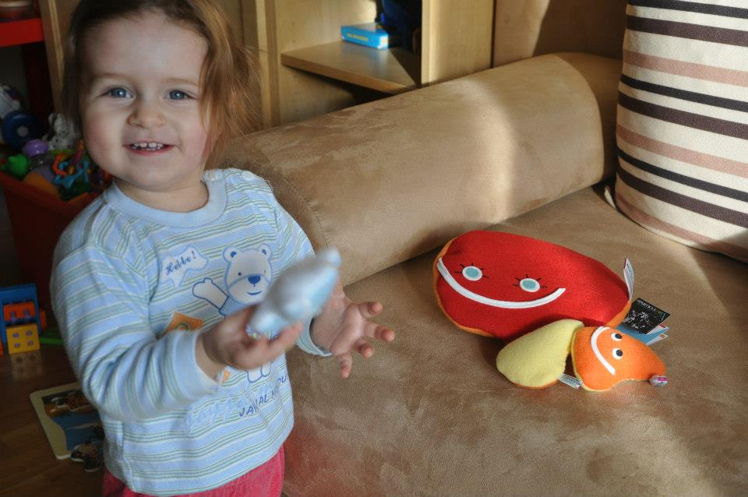
Exploring Structure of the Proton
:Elctromagnetic Probe
Neural Networks vs. Theory
and TPE studies
probably quark u
Data
Theory
gluon
proton
ν @ IFT @

Slide 15
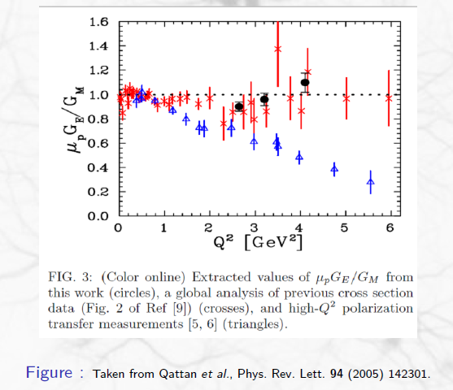
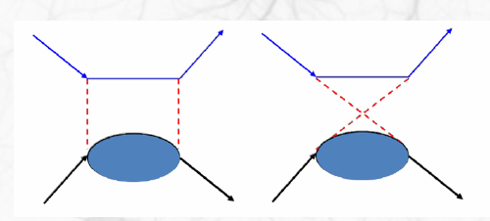
e
e
e
e
?
?
p
p
p
p
Two-Photon Hard Contribution,
which account for nontrivial hadronic
Structure
Investigation of the off shell nucleon
properties
TPE plays important role in the proton radius estimation!
ν @ IFT @

Slide 16
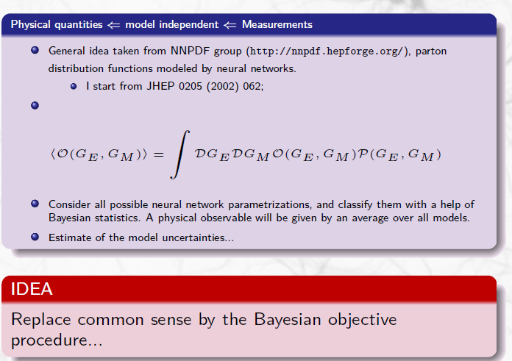
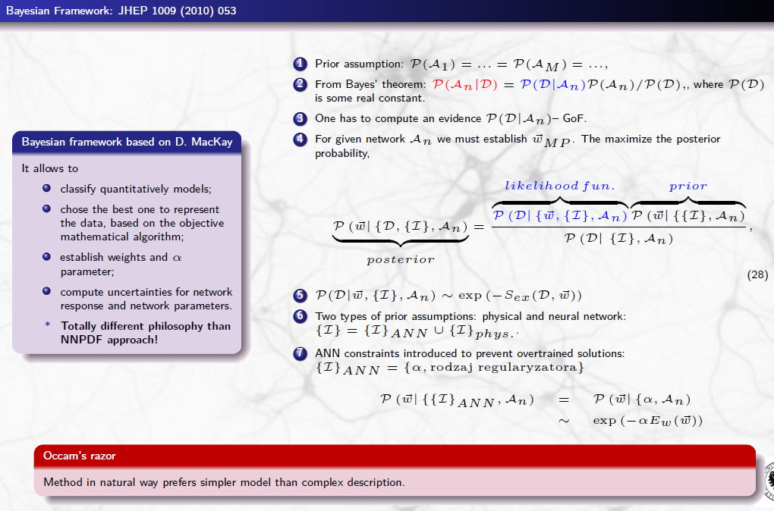
KMG, P. Plonski, R. Sulej, JHEP 1009 (2010) 053
ν @ IFT @

Slide 17
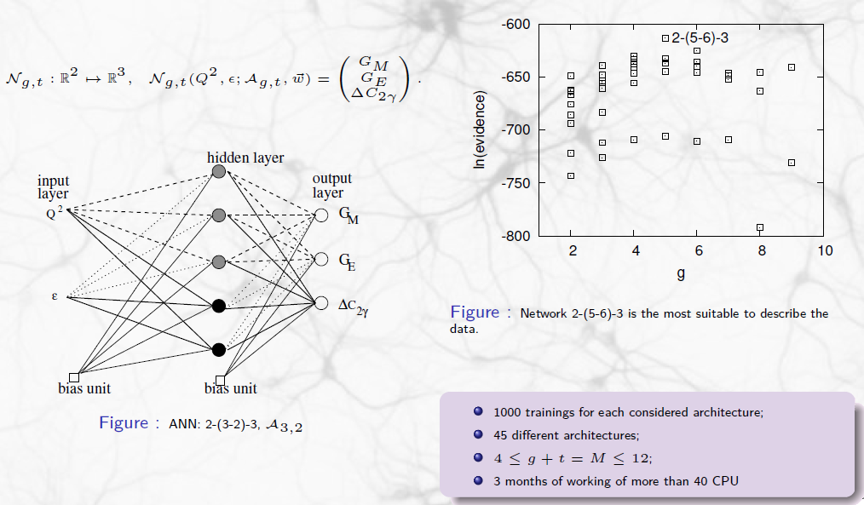
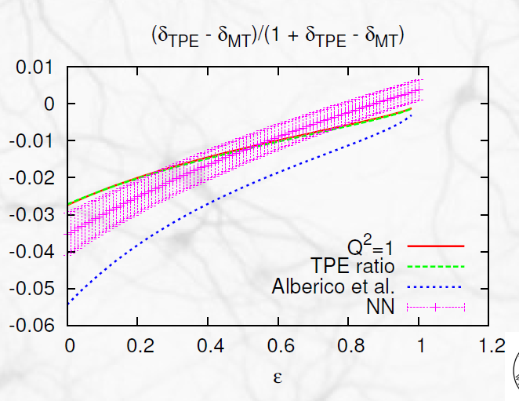
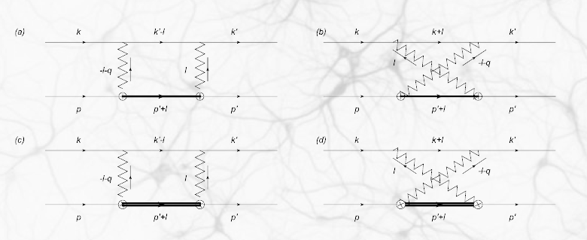
K.M.G, Phys. Rev. C 84, 034314 (2011)
KMG, in arxive March, 2013
Preliminary
Loop calculations
ν @ IFT @

Slide 18
Future
Further NuWro developing
  developing existing NuWro intranuclear cascade model
  adding a new module with electron and photo nucleon/nucleus interactions.
multinucleon emission contribution to the neutrino interaction cross section
Detailed studies of Δ(1232) resonance region
Two boson exchange effect in lepton scattering off nucleons
Developing of NN methods
ν @ IFT @

